Slide 1

Automating the Campaign Creation Process
Updated Q4 2012

Slide 2
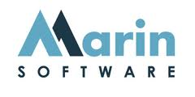


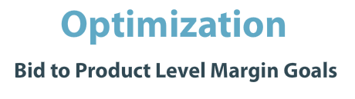
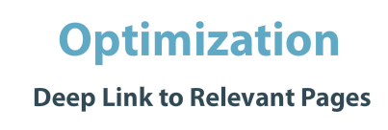
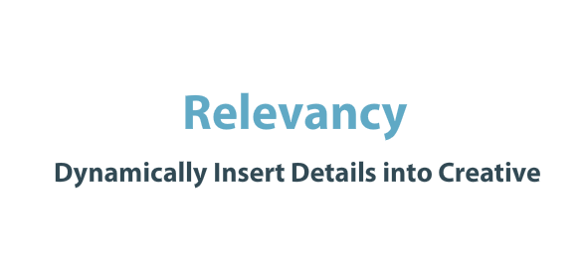
Background/Brief
The adidas Challenge..
Background
Adidas is a leading sports retailer with thousands of products available on their ecommerce shop site at any one time.
The PPC activity managed by iProspect has been working to implement solutions that automates new campaigns & also capture long-tail product focused keywords.
Brief
It has been a challenge to implement and manage effectively campaigns that promote all of the unique products available on the adidas site.
Marin has the ability to dynamically create campaigns based on a product feed. The goal was to introduce and utilise this feature for adidas.

Slide 3






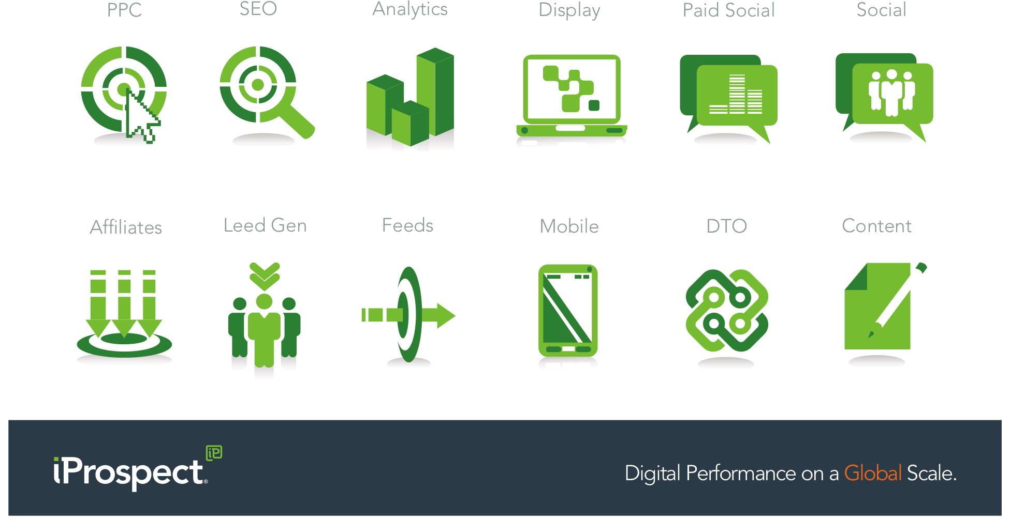

Challenge
Feed Setup and Marin Integration
Feed Setup
We worked with the iP US to tailor the product feed in line with Marin requirements.
Marin makes use of the this feed and a template that we setup to create long tail keywords with specific creative that highlights the product and the current price.
Challenges
The initial feed was not setup for PPC so titles did not fit within character requirements and columns were missing. Multiple versions were required before settling on one that would provide the required outcome.
A template had to be setup and tested before activity could be set live.

Slide 4
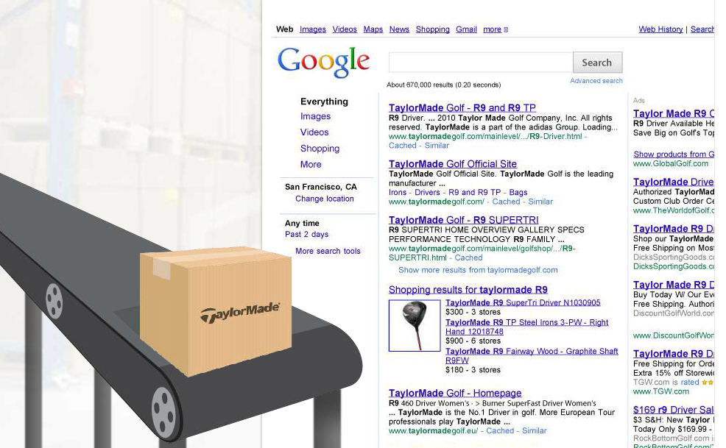
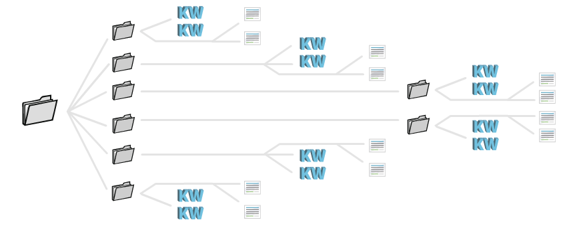

Strategy
Better Keywords & Automated Approach
Targeted Keywords
The system was able to automate long tail and specific product focused keywords to each product.
Due to this tailored approach to the keywords and creative the Cost of Sale for the activity has consistently remained below the targeted 18% threshold and the average position for the account beats the normal activity at all times.
Automated Approach
The set-up required the creation of a new product feed and integration with the Marin template. Following this, the activity was allowed to run automatically.
The campaigns, ad groups, keywords and creative are all created without any direct input. iP UK applied tailored templates and rules which automates this process.

Slide 5

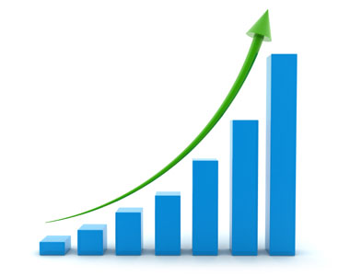



results
Improved Resource and User Experience
Improved Resource
Automated solution improved resource. After the initial setup the feed is updated daily and the team only needs to check to make sure it’s all in order.
Better User Experience
The keywords are long tail and creative is specific to each individual product. CTR improved & helping to provide a better user experience by deeplinking the visitors directly to the product that triggered the search.
Client Approval
Adidas has been very interested with the overall activity and once the testing of the UK market has been completed they have voiced their interest in seeing this rolled out to all the other EU markets where this technology is available.

